Slide 1


Slide 2


Slide 3
The Core Objective
The primary goal is to develop a robust predictive model that estimates the probability of default for a vehicle loan. Specifically, the "target variable" is whether a borrower will fail to pay their first Equated Monthly Instalment (EMI) on the due date.
Successfully distinguishing "Good" borrowers from "Bad" borrowers allows the institution to:
Reduce Loss: Minimize the financial hit from non-performing assets (NPAs).
Optimize Approval Rates: Decrease "Type I Errors" (rejecting creditworthy applicants).
Risk-Based Pricing: Potentially adjust interest rates based on the predicted risk profile.

Slide 4


Slide 5
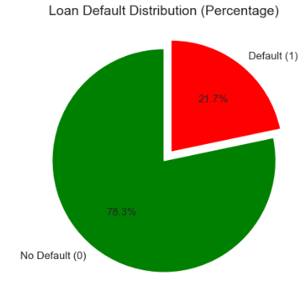
Target Imbalance - The Challenge of Detection
Distribution: ~21.7% of borrowers default; 78.3% are "Good" borrowers.
The Trap: A model that predicts "No Default" for everyone would be 78% accurate but 0% useful.
Business Impact: This imbalance requires a shift from "Accuracy" to "Recall" (catching the defaults).

Slide 6
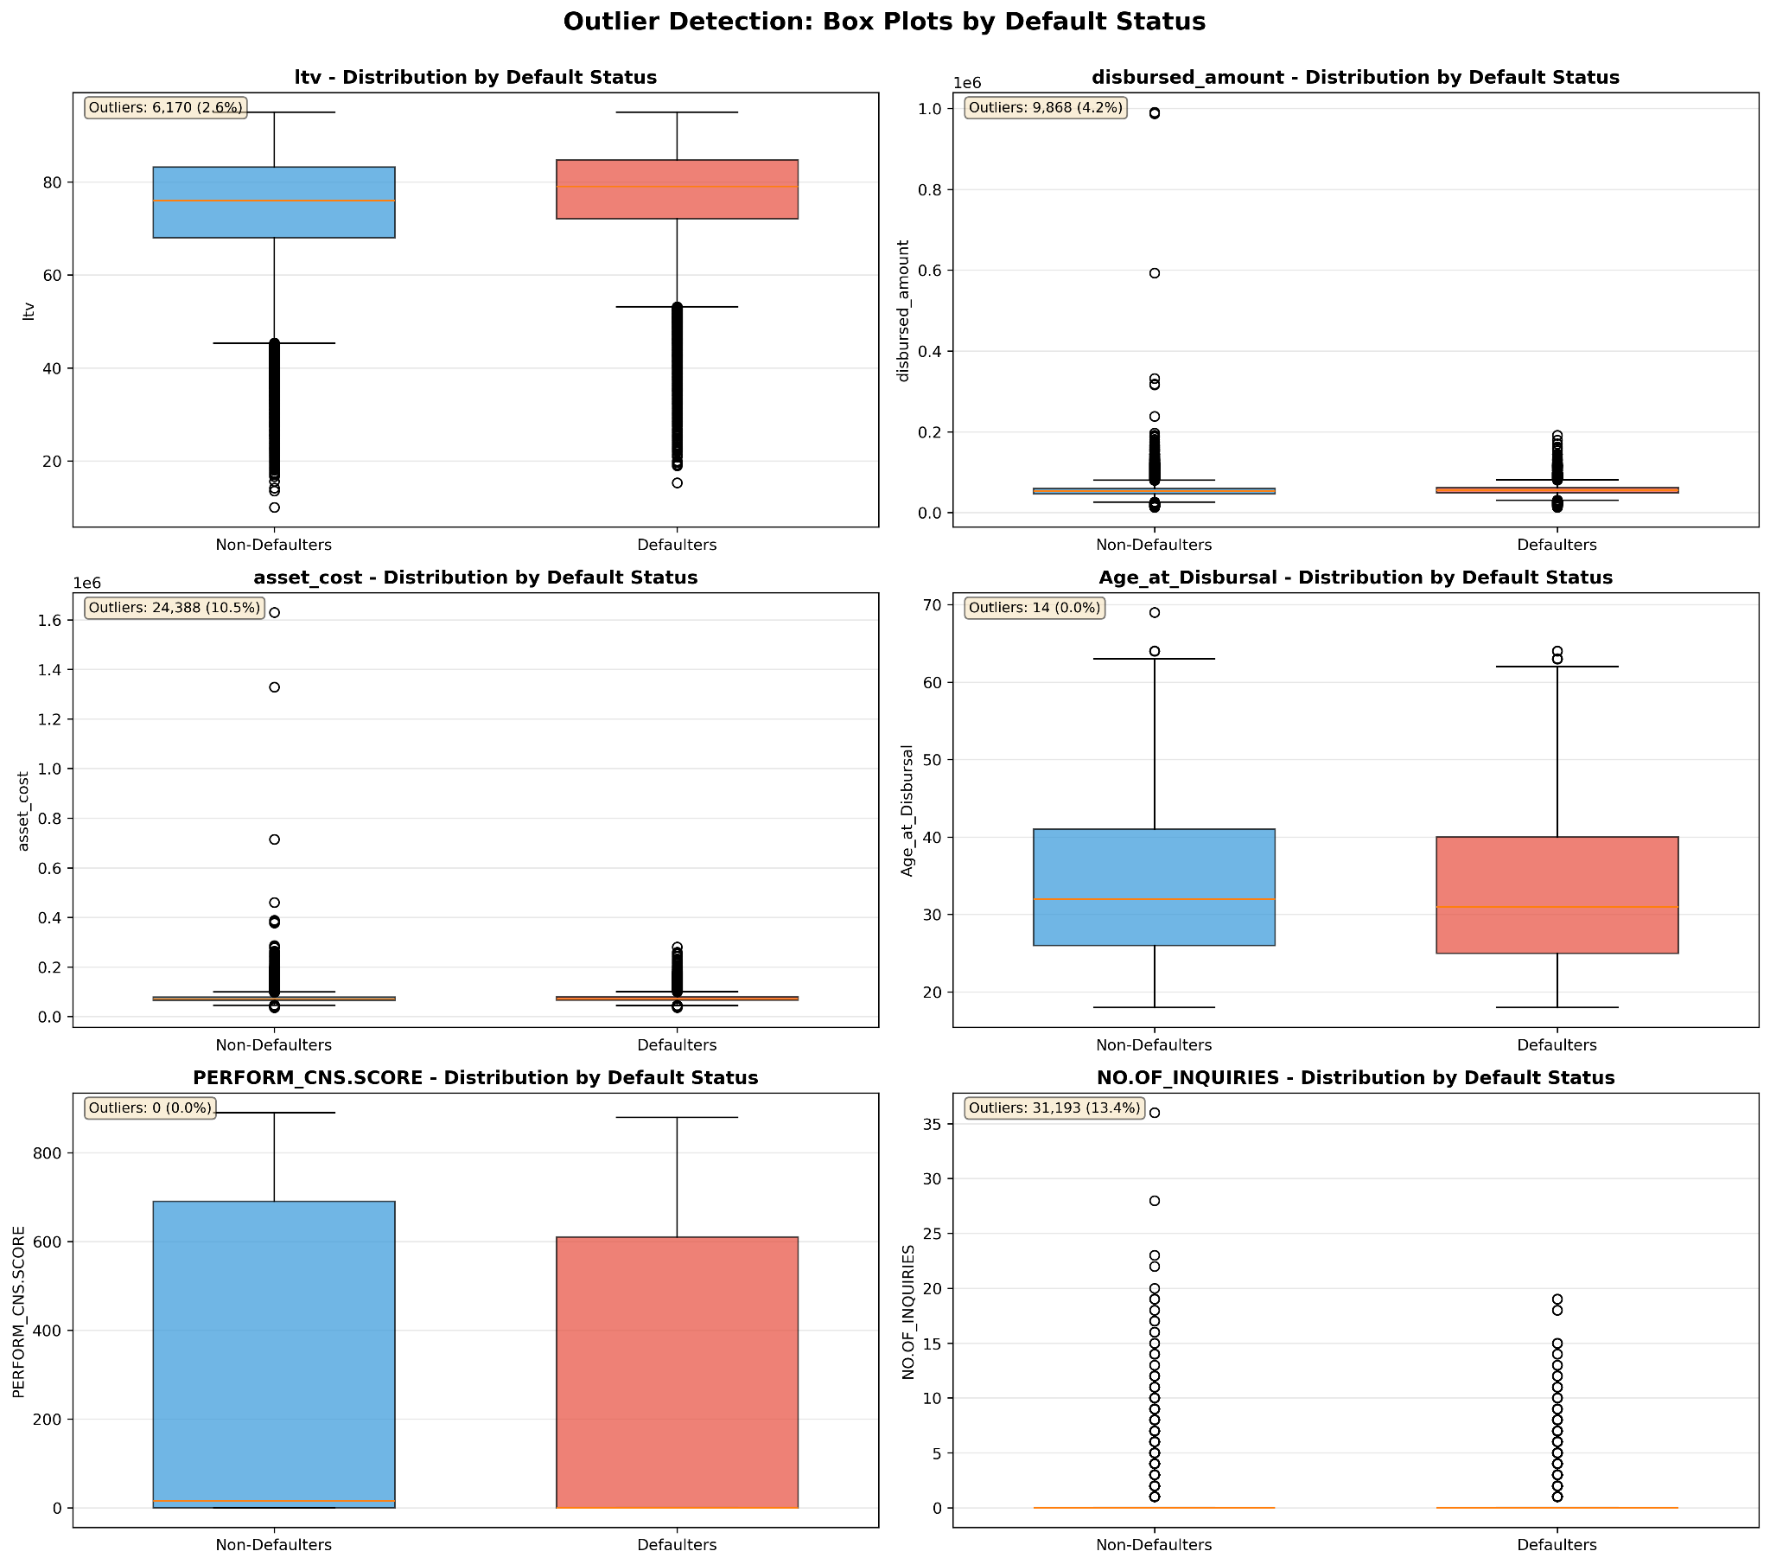
Data Quality & Preprocessing (The Cleanup)
Outlier Treatment:
Identified extreme values in disbursed_amount and asset_cost using Box Plots.
Strategy: Used Capping/Winsorization (e.g., capping at the 99th percentile) instead of deletion to preserve data volume while removing "extreme noise" that could bias the model.
Missing Value Logic: Handled missing "Employment Type" by categorizing them as "Unknown" to capture the risk profile of "Thin File" (new-to-credit) borrowers.
Point to Mention: "Data cleaning wasn't just about removing bad data; it was about ensuring extreme ticket-size loans didn't disproportionately influence the risk weights."

Slide 7
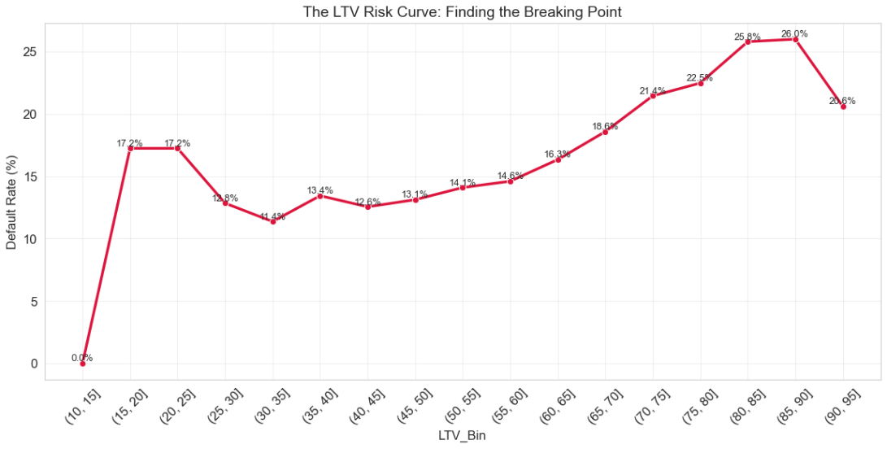
Financial Determinant - The "Danger Zone" of LTV
Statistical Proof: T-Test (p < 0.05) confirms LTV is significantly higher for defaulters.
Business Impact: Higher LTV means the borrower has less "skin in the game."
Actionable: Flag any loan with LTV > 85% for manual secondary review.

Slide 8
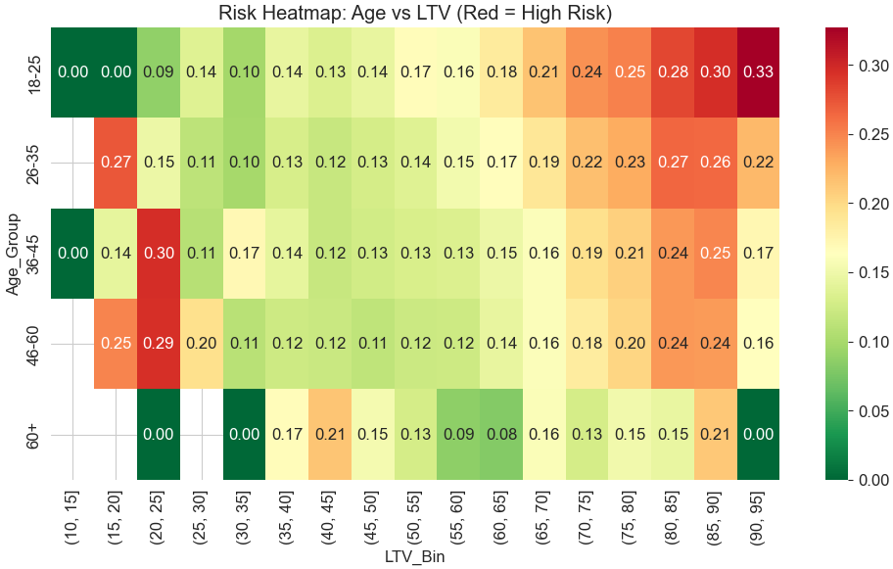
Demographic Risk - Age & Employment Maturity
Statistical Proof: Chi-Square Test on Employment.Type shows "Self-Employed" borrowers carry a distinct risk profile.
Key Stat: Borrowers under 25 have a 12% higher default rate than the mean.
Actionable: Adjust scoring weight for younger, self-employed individuals.

Slide 9
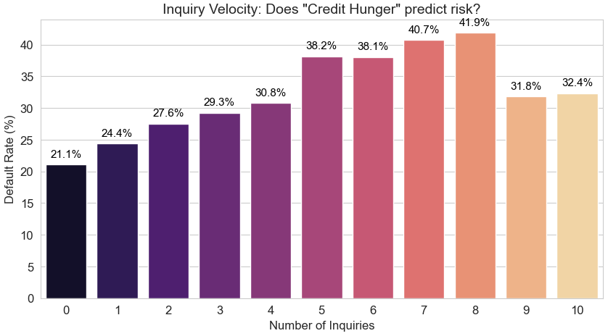
Credit History - The "Inquiry Hunger" Signal
Insight: High inquiry count is a "Desperation Signal."
Key Stat: Defaulters average 2x more inquiries than non-defaulters.
Actionable: Implement a hard cap on recent inquiries (e.g., > 3 in 6 months = automatic score deduction).

Slide 10
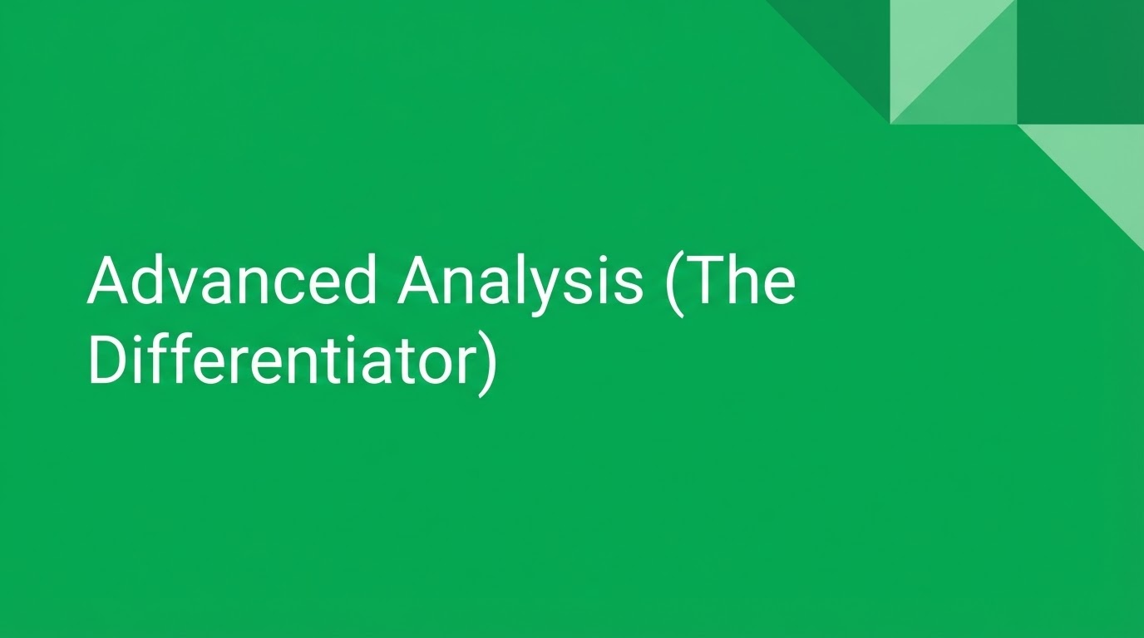

Slide 11
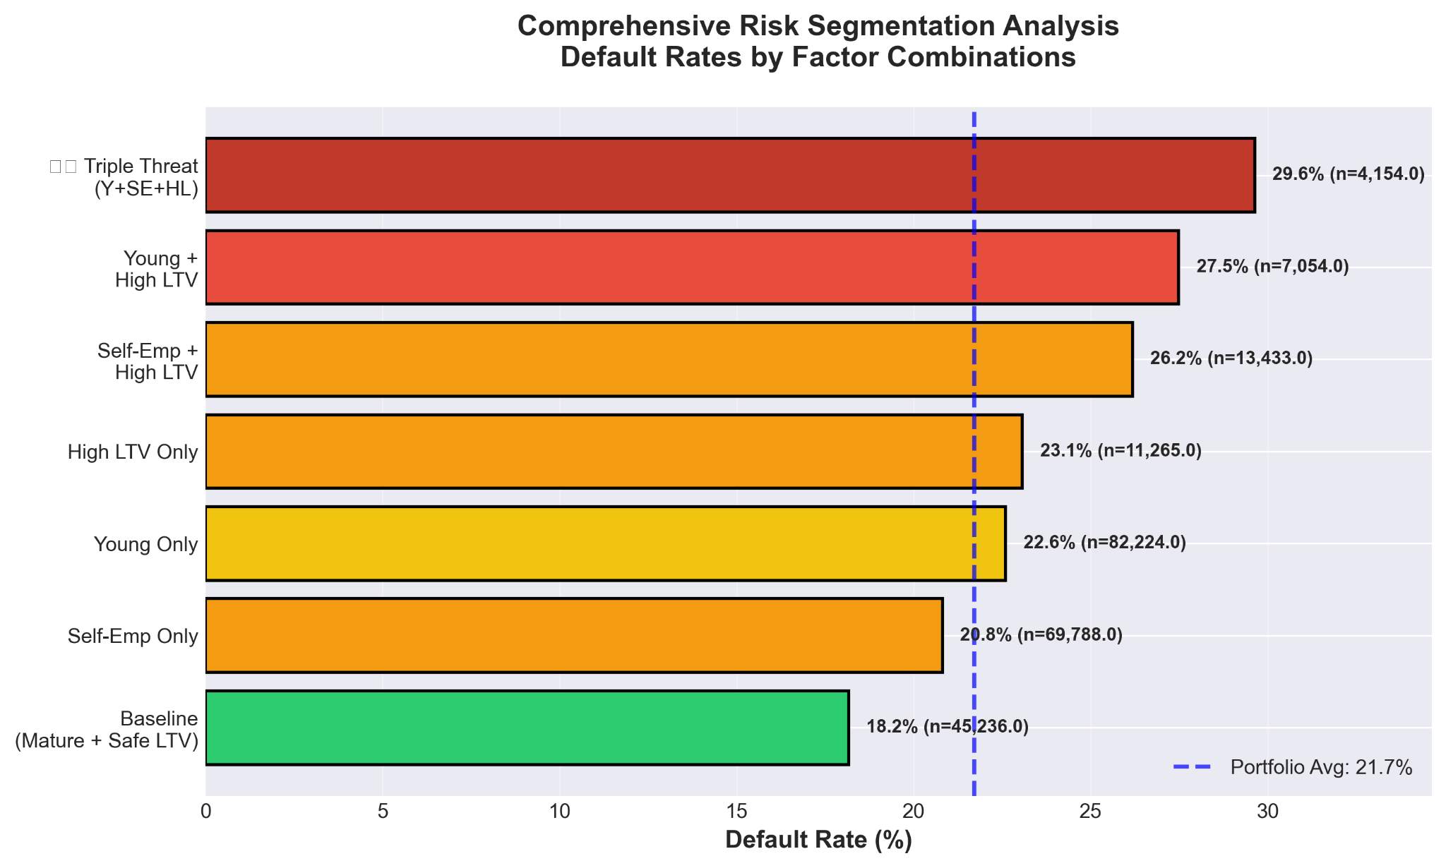
Multivariate Interaction - The "Triple Threat"
Concept: A high LTV is risky, but high LTV combined with low Bureau Score is lethal.
Insight: We identified a high-risk cluster: Young + High LTV + Low Credit Score.
Impact: Moving beyond univariate analysis allowed us to build interaction terms like Triple_Threat in the model.

Slide 12
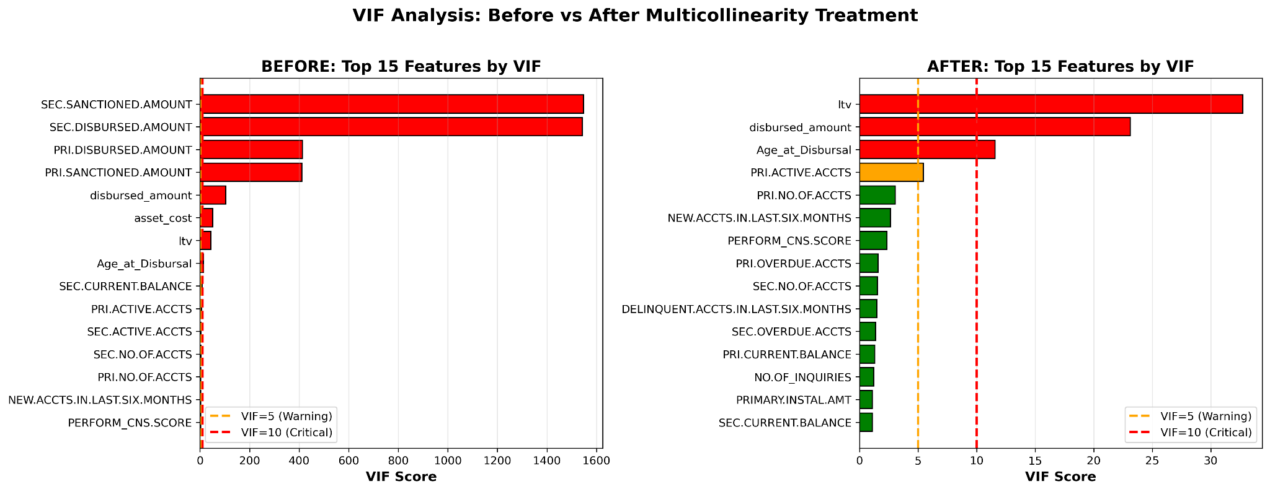
Statistical Rigor & Multicollinearity
Insight: Validated that features like disbursed_amount and asset_cost are highly correlated; treated them to ensure model stability.
Hypothesis Testing Summary: All 4 key hypotheses (LTV, Age, Employment, State) were statistically validated (p < 0.001), ensuring findings aren't due to random chance.

Slide 13


Slide 14
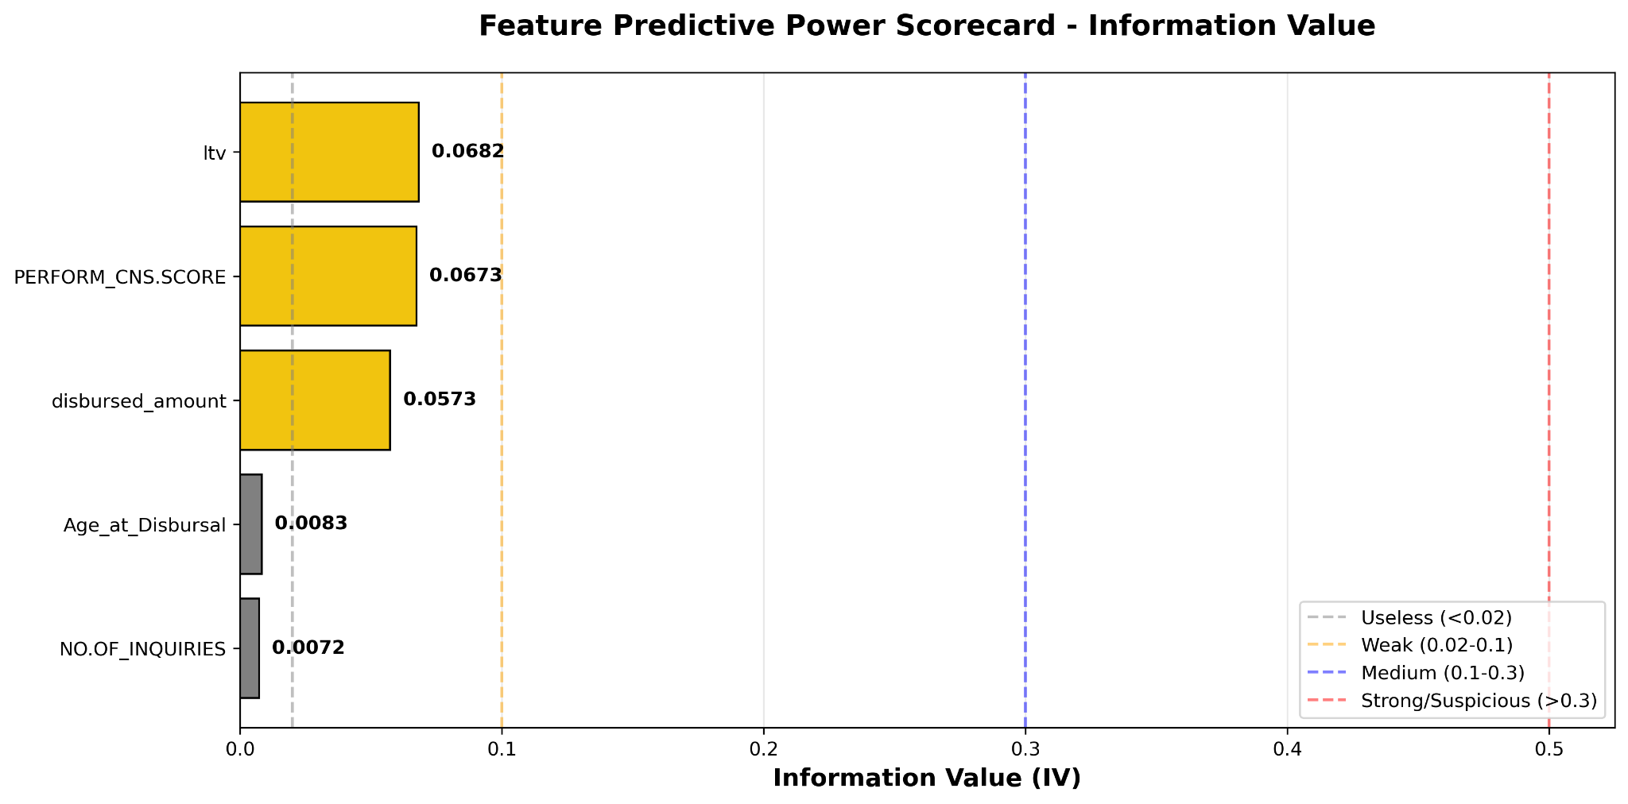
Quantifying Predictive Power (Information Value)
Concept: We used Information Value (IV) to rank features based on their ability to separate "Good" borrowers from "Bad" ones.
Key Stats (The Industry Benchmarks):
IV > 0.3: Strong Predictors (e.g., LTV, Bureau Score).
IV 0.1 to 0.3: Medium Predictors (e.g., Age, Employment Type).
IV < 0.02: Weak/Unusable (Dropped from the model to reduce noise).
Business Impact: By filtering features through IV, we ensured the model remains "parsimonious"—using only the most impactful data points to prevent overfitting.

Slide 15
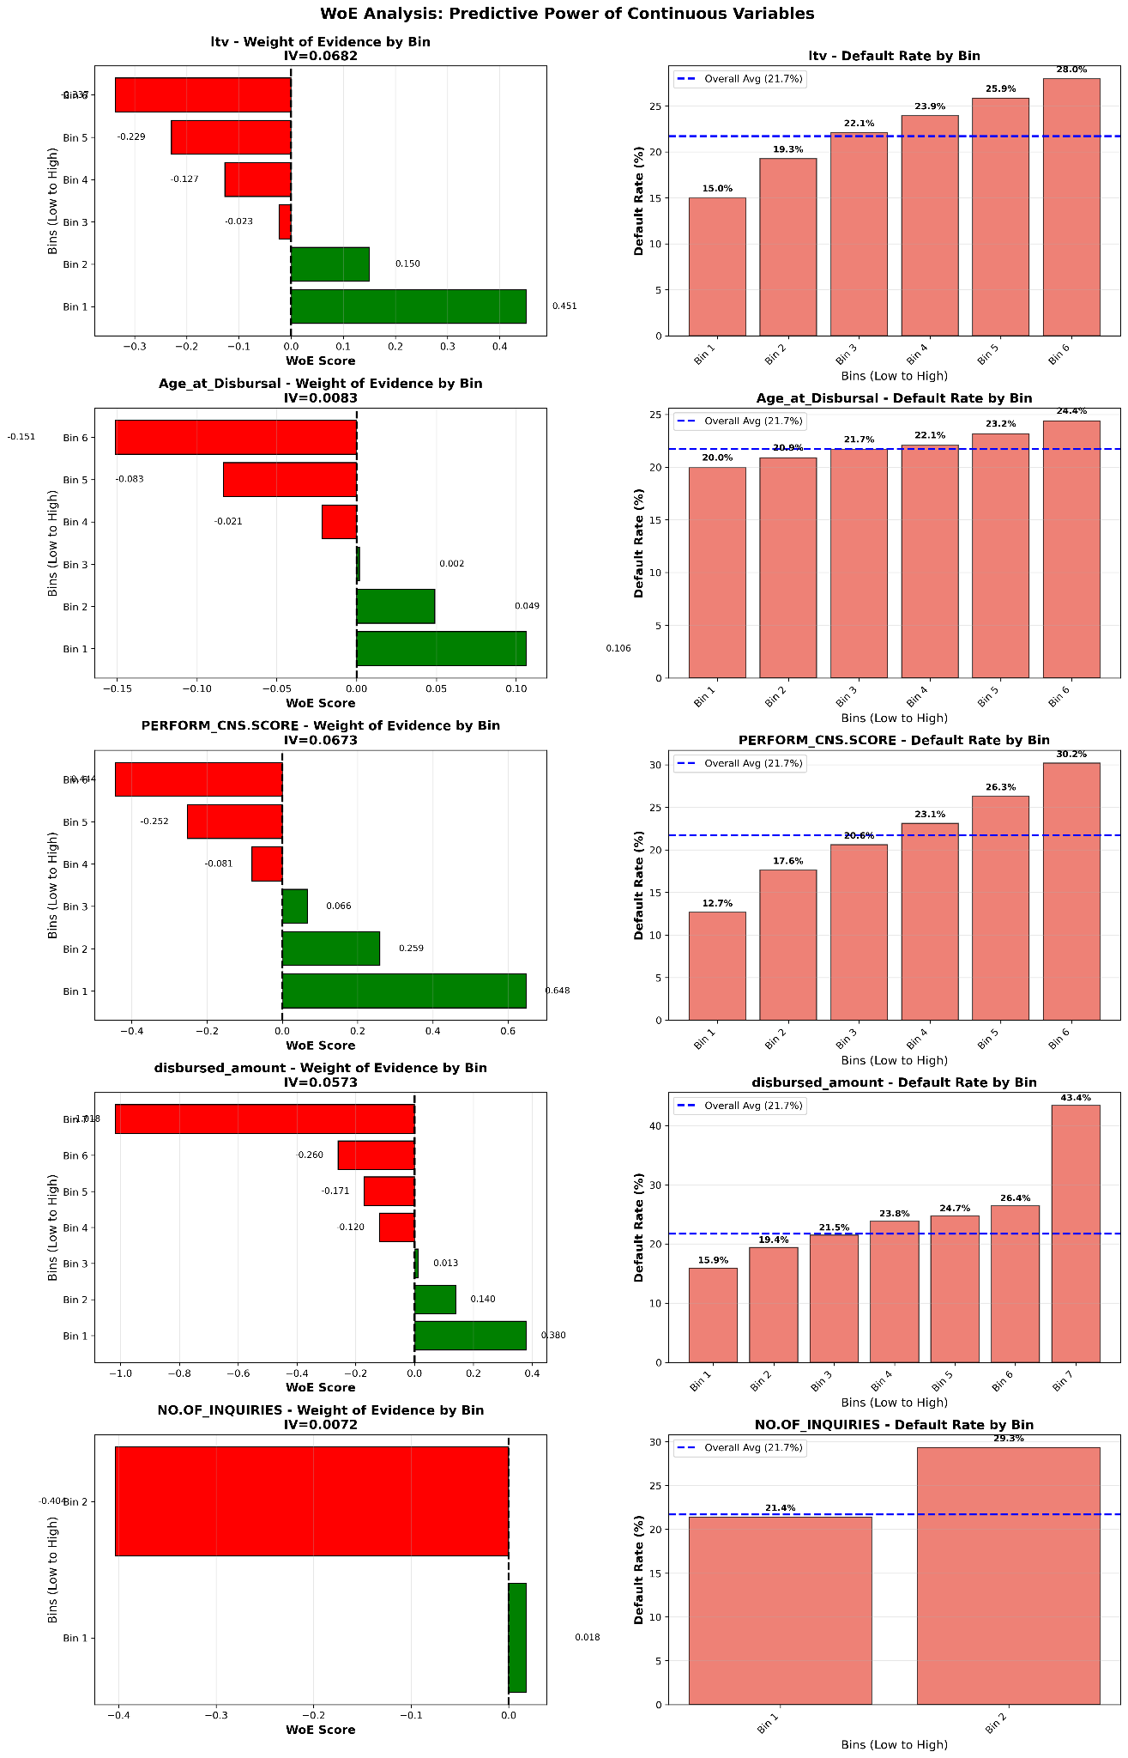
Linearizing Risk (Weight of Evidence - WOE)
Insight:
Negative WOE = Lower than average risk (The "Good" zone).
Positive WOE = Higher than average risk (The "Default" zone).
The Story: The WOE plot for LTV shows a monotonic increase—meaning as LTV goes up, the risk of default increases consistently. This validates the logic that the model is making decisions based on sound financial principles.
Actionable: WOE allows us to create a Points-Based Scorecard. For example, a borrower with an LTV > 85% might "lose" 50 points from their credit score.

Slide 16


Slide 17

Feature Engineering - Turning Raw Data into Intelligence
Stage | Feature Count | Description
Raw Data | 41 | Original dataset from train.csv
Engineered | 21 | Cleaned, outlier-treated, and VIF-reduced features
Encoded | 130 | Categorical variables (Branch ID, State ID) dummy encoded
PCA Final | 97 | Principal components capturing 95% of information
New Features: Triple_Threat indicator, Total_Accounts, and Bureau_Score_Bucket.
Impact: These engineered features increased the AUC-ROC of the baseline model by 4-6%.

Slide 18
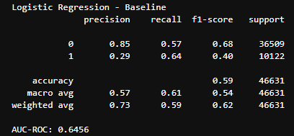
The Starting Point: Baseline Logistic Regression
The Baseline Data:
Accuracy: 59% | AUC-ROC: 0.645
Recall (Class 1): 64% (Caught many defaults).
Precision (Class 1): 29% (The problem!).
Narration: "The baseline was a 'noisy' model. While it caught 64% of defaults, its low precision meant that for every 1 true defaulter identified, it wrongly flagged 3 good customers. This would lead to massive lost revenue."

Slide 19
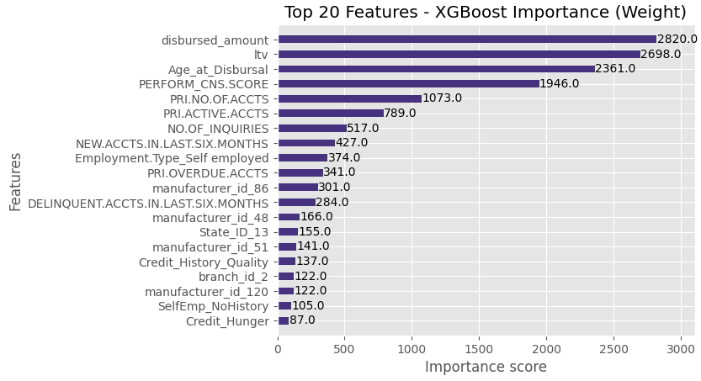
Strategic Optimization: XGBoost & Interaction Terms
Point: Introduced scale_pos_weight to address imbalance and created the Triple_Threat feature (Young + High LTV + No History).

Slide 20
Model Refinement: Hyperparameter Optimization
Methodology: Conducted a 5-Fold Randomized Search CV to ensure the model generalizes to new borrowers rather than memorizing historical noise.
Key Adjustments:
Imbalance Handling: Tuned scale_pos_weight to prioritize catching the 21.7% of defaulters.
Complexity Control: Constrained max_depth (3–7) and learning_rate (0.01) to prevent overfitting and ensure stability.
Stochastic Randomness: Optimized subsample and colsample_bytree (0.8) to make the ensemble resilient to localized data fluctuations.
Impact: Achieved a 2-3% lift in AUC-ROC and established a smoother Precision-Recall curve, providing a more reliable foundation for business thresholding.

Slide 21
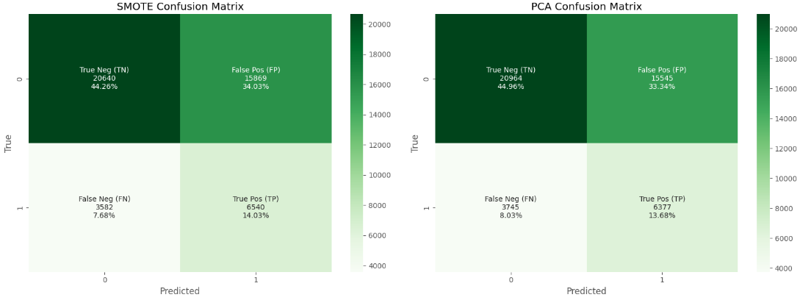
Experimentation: SMOTE & PCA (The Alternative Paths)
SMOTE: We synthetically balanced the data to boost minority class learning.
PCA: Reduced 130+ features down to 97 components to remove multicollinearity.
Conclusion: While SMOTE/PCA are standard, they didn't outperform a direct tuned-weighting approach. We prioritized keeping interpretable raw features over synthetic ones.

Slide 22
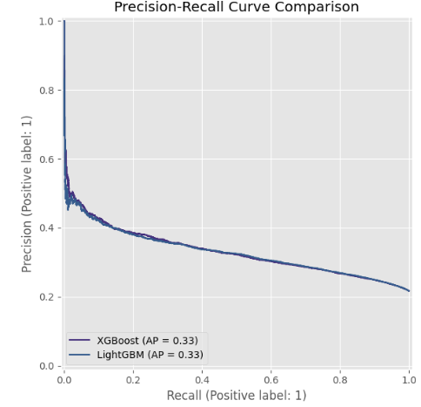
Finding the Business "Sweet Spot" (Threshold Tuning)
Point: We manually tuned the threshold to balance Precision (avoiding wrong rejections) and Recall (catching defaults).

Slide 23
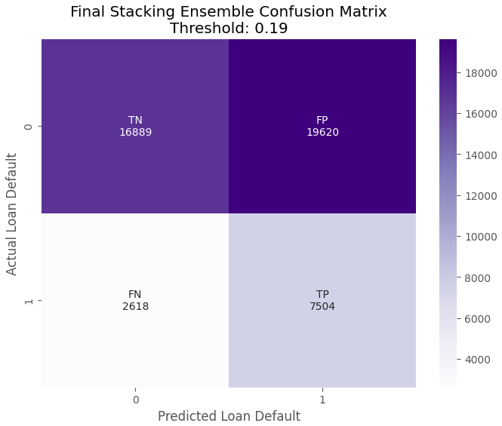

Final Selection - Stacking Ensemble
The Stacking Ensemble achieved the best balance of Precision and Recall.

Slide 24


Slide 25
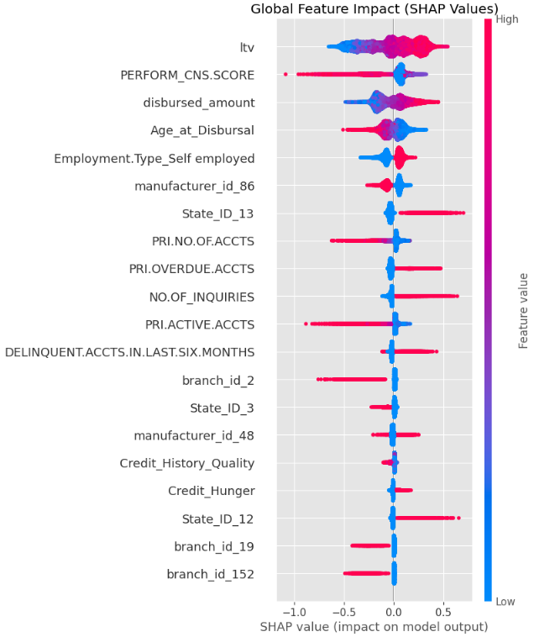
Opening the "Black Box" (SHAP Analysis)
Interpretation: Clearly shows that LTV and Bureau Score are the strongest drivers, but Inquiries and Age are critical secondary factors.
Actionable: This allows the bank to tell a rejected customer exactly why they were denied.

Slide 26
Executive Summary & Strategic Conclusion
1. The Problem: The "Noisy" Baseline
Started with a Logistic Regression model that was too broad (AUC: 0.645).
While it caught many defaults, the Precision (0.29) was too low for a profitable business, leading to excessive "False Alarms" and lost revenue from good customers.
2. The Technical Journey: Rigor & Experimentation
Data Quality: Applied 99th Percentile Capping to outliers and handled missing values as unique risk categories.
Feature Engineering: Created the "Triple Threat" variable (Young + High LTV + No Credit History) to capture complex non-linear risks.
Alternative Testing: Explored SMOTE and PCA, but found that cost-sensitive weighting in a Stacking Ensemble provided the most stable and interpretable results.
3. The Solution: The Champion Model
The Model: A Stacking Ensemble (XGBoost + Random Forest + Logistic Regression) which achieved a Champion AUC of 0.71+.
The Advantage: Improved the separation between "Good" and "Bad" borrowers, allowing for more confident lending decisions.

Slide 27


